Slide 1

Secure Savings
Progress Presentaion CodeCrafters
Programming Hero
Let’s Code _ Your Career

Slide 2
CodeCrafters
Presented by
Team : CodeCrafters
Code : 803.3
Leader:
Developer:
Presented to
Tandra
Project Manager
Programming Hero
Md Rifadul Islam
Md Rabby
Mosaddek Hossen
Md Rana
Sadia Rahman
Saiful Islam

Slide 3
01.
Project Description -SRC
04.
Responsive UI Design
02.
Add Sprint Details in Trello
05.
Deploy the site in a Live link
03.
Github Setup
06.
Research on Features Development

Slide 4

Project Description -SRC
Name
Goal
Features

Slide 5
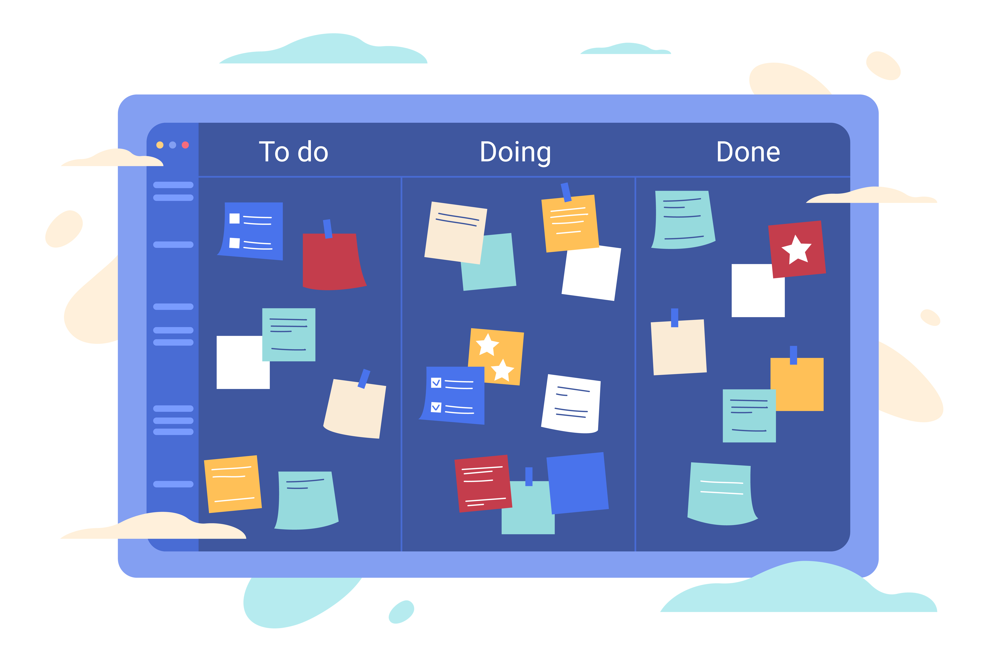
Add Sprint Details in Trello
Trello Setup
Task Design
Admin Role

Slide 6

GitHub Setup
GitHub Repository
GitHub Forks
GitHub Issue

Slide 7

Responsive UI Design
Mobile-First Approach
Flexible Grid Layouts
Touch-Friendly Design

Slide 8
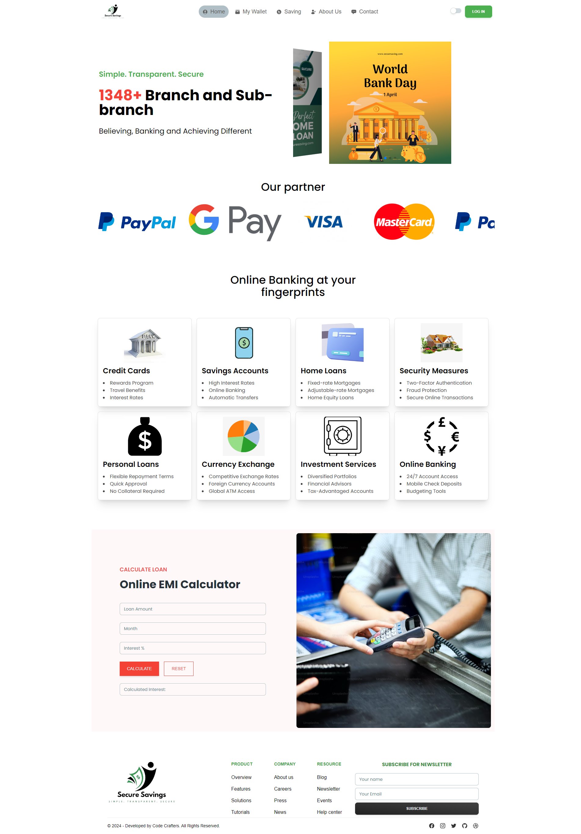
Deploy Site in a Live link
Live Site: https://secure-savings.vercel.app/

Slide 9

Research on Features Development
Comfortable User Experience

Slide 10
Thank You!

